Slide 1
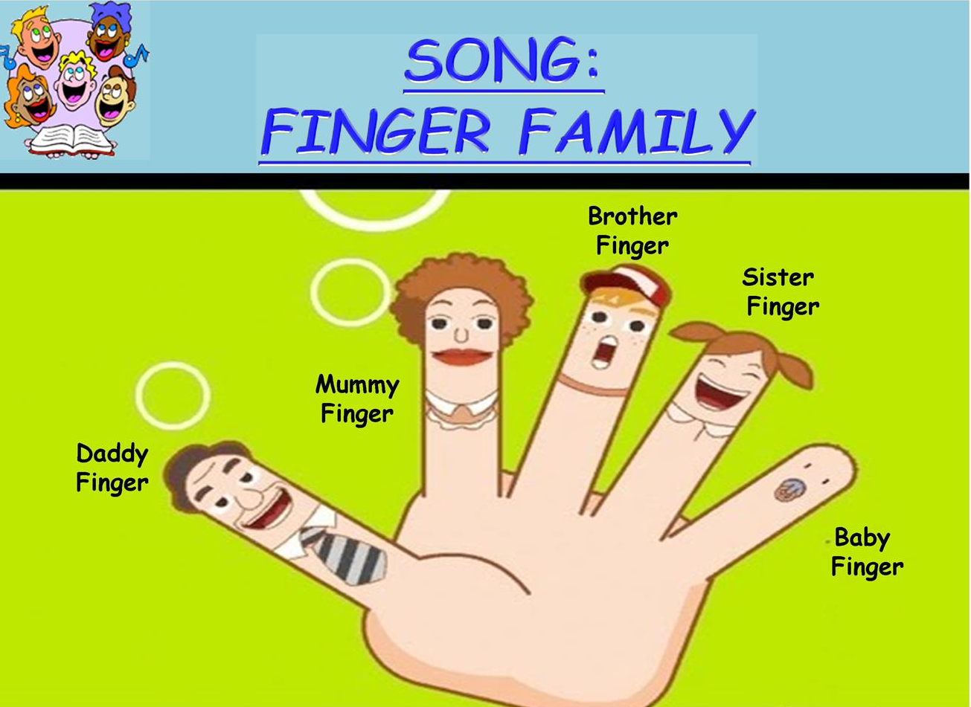

Slide 2
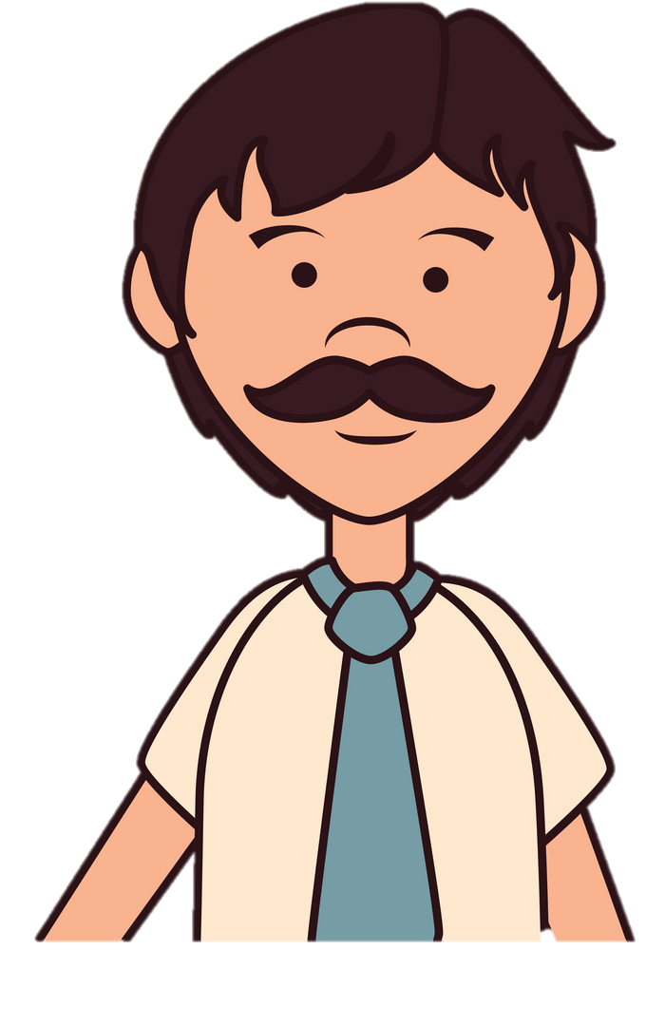
This is my daddy

Slide 3

This is my mommy

Slide 4

This is my brother

Slide 5

This is my sister

Slide 6
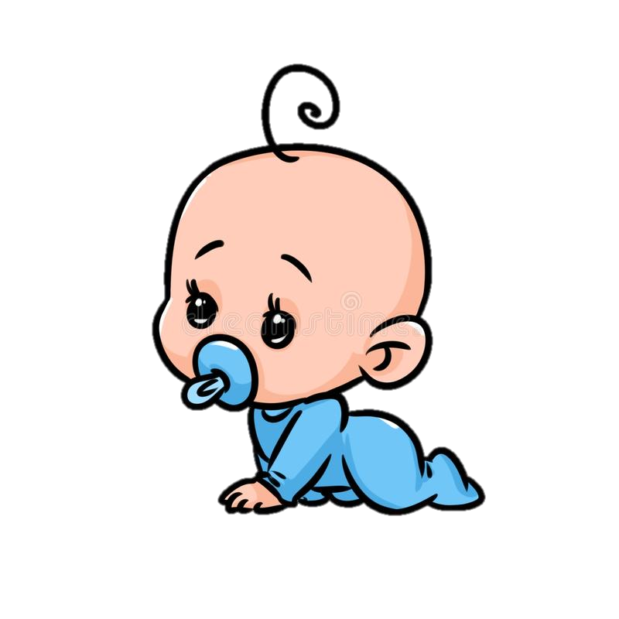
This is baby

